Slide 1

Use methods

Slide 2
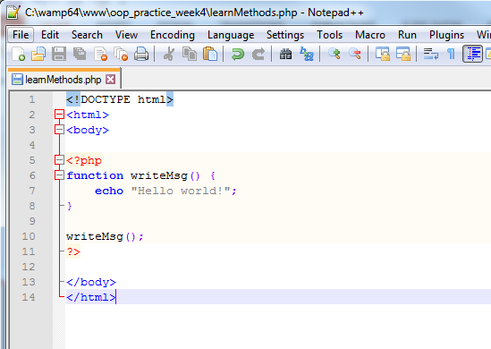

Slide 3
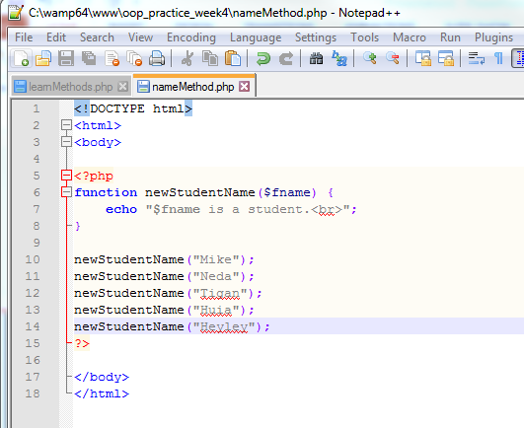

Slide 4
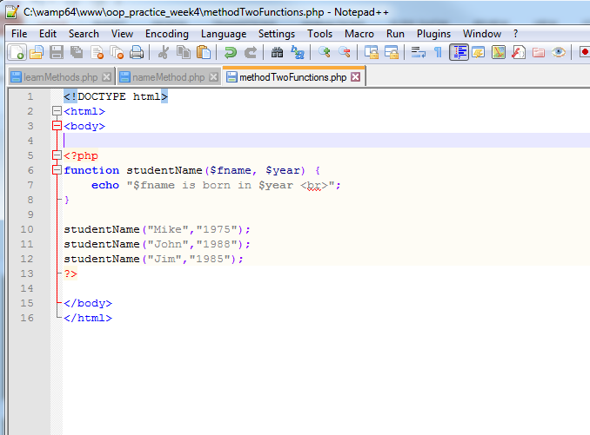

Slide 5
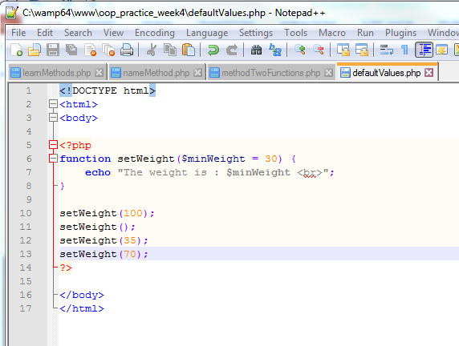
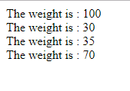
Use a default parameter. If we call the function setWeight() without arguments it takes the default value

Slide 6
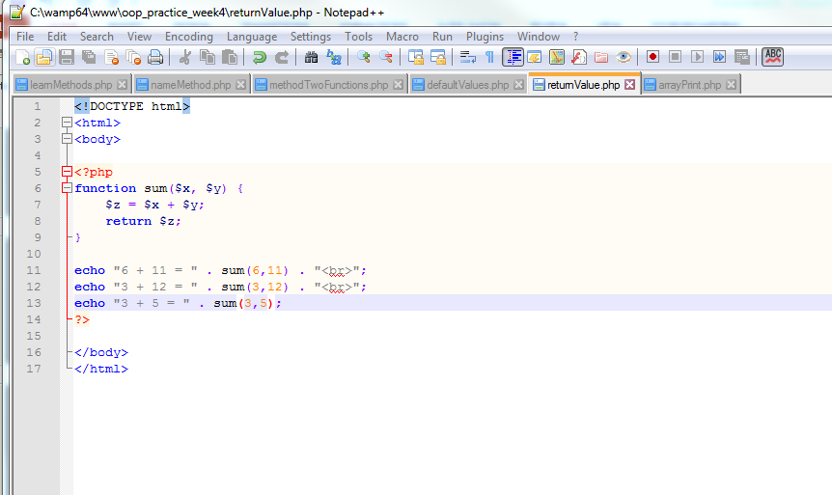
Php functions – returning values

Slide 7
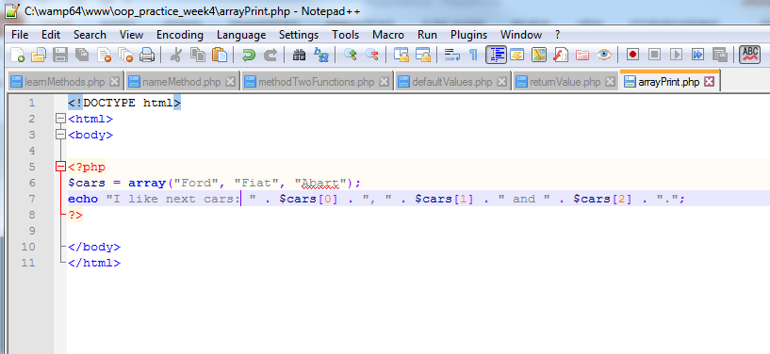

Slide 8
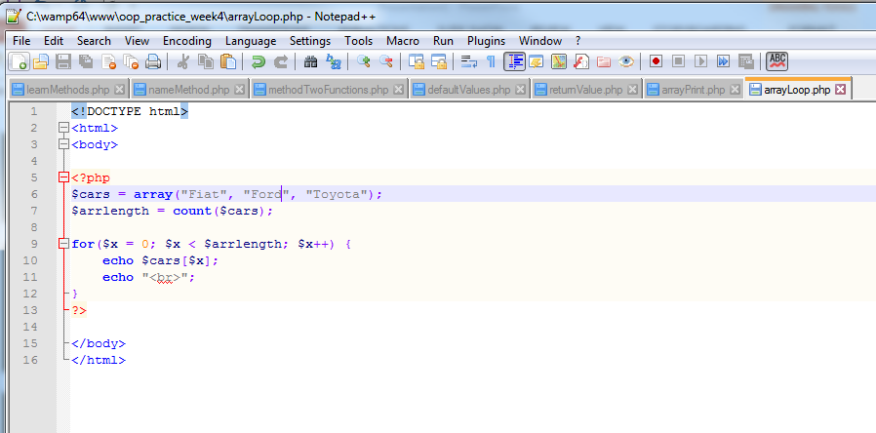
Loop through an indexed array

Slide 9
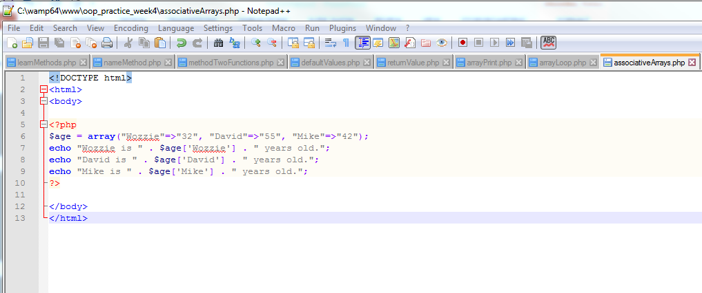
Associative arrays
Associative arrays are arrays that use ‘named keys’ that you assign to them (Instead of Indexing).
The above example has 3 ‘named keys’ – ‘Wozzie’, ‘David’,’ Mike’

Slide 10
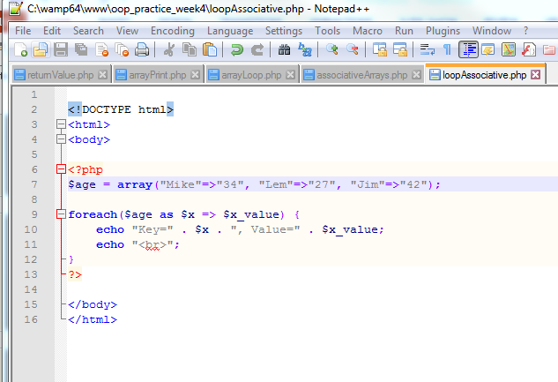
Loop through an associative Array

